Slide 1
Ai-Powered Nutrition Analyzer for Fitness Enthusiasts
GE19612 - PROFESSIONAL READINESS FOR INNOVATION,
EMPLOYABILITY AND ENTREPRENEURSHIP
MALLESH U (210701145)
NARESH KUMAR V(210701323)
MATHESH WARAN K(210701155)

Slide 2
ABSTRACT
This paper presents a system for classifying and assessing the nutritional value of fruits and vegetables using deep learning. The system employs a pre-trained convolutional neural network (CNN) model to identify various produce items from images. Once classified, the system uses the USDA's FoodData Central API to retrieve nutritional information, which is then compared against predefined nutritional thresholds. If an item falls short, the system suggests more nutritious alternatives. The core functionality is implemented in a Python script utilizing Keras for deep learning, PIL for image processing, and requests for API communication. Results are displayed within a user interface, offering an interactive platform for users to understand the nutritional content of their food. This integration provides a valuable tool for dietary management and education.

Slide 3
PROBLEM STATEMENT
Many individuals struggle to identify fruits and vegetables and understand their nutritional content, which hinders their ability to make informed dietary choices. Current methods often require manual input and nutritional knowledge, making them less accessible. There is a need for an automated, user-friendly tool that uses deep learning to classify produce from images and provides real-time nutritional information. Such a system should also suggest healthier alternatives when necessary, aiding users in making better dietary decisions effortlessly.

Slide 4
Existing System
Current systems for identifying fruits and vegetables and obtaining nutritional information often rely on manual input and user knowledge. Mobile apps and online databases, such as the USDA FoodData Central, require users to search for items manually. Barcode scanners are effective for packaged produce but not for fresh items. Diet tracking apps like MyFitnessPal offer nutritional information based on user input but can be inconvenient and less accurate for fresh produce. These methods lack ease of use, accuracy, and real-time image-based identification, and they do not provide automatic suggestions for more nutritious alternatives, limiting their effectiveness in dietary management.

Slide 5
PROPOSED SYSTEM
The proposed system integrates deep learning and real-time image recognition to automatically identify fruits and vegetables from images and retrieve detailed nutritional information from the USDA's FoodData Central API. It utilizes a pre-trained convolutional neural network (CNN) for accurate image classification, providing instant identification without manual input. Nutritional data fetched from the API is evaluated against predefined thresholds to determine healthiness, and if an item falls short, the system suggests healthier alternatives. With a user-friendly interface, users can effortlessly upload images and receive immediate feedback on nutritional content, aiming to facilitate informed dietary choices seamlessly.

Slide 6
Aim and Objective
Aim:
The aim of this project is to develop a comprehensive system for automated classification and nutritional assessment of fruits and vegetables using deep learning techniques, facilitating informed dietary choices effortlessly
Objectives:
1. Develop Image Classification Model
2. Implement Nutritional Assessment
3. Provide Alternative Suggestions

Slide 7
Literature survey
Recent literature underscores the increasing adoption of deep learning for food classification and nutritional analysis. Studies predominantly emphasize the effectiveness of convolutional neural networks (CNNs) in accurately identifying fruits and vegetables from images. Integration with APIs like the USDA's FoodData Central enables real-time retrieval of detailed nutritional data, empowering users to make informed dietary decisions based on calorie content, macronutrient composition, and micronutrient levels. With a surge in health-conscious lifestyles, there's a corresponding rise in demand for user-friendly applications offering personalized dietary recommendations and intuitive interfaces for seamless interaction. However, challenges such as dataset availability, food variation, and ensuring accuracy in nutritional data retrieval persist, suggesting avenues for further research and improvement in automated food classification systems.

Slide 8
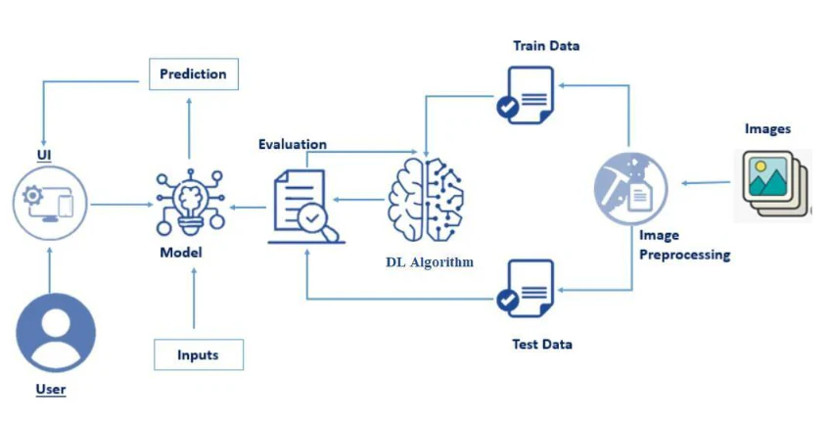
Architecture Diagram

Slide 9
Functional Description
The proposed system aims to provide automated classification and nutritional assessment of fruits and vegetables through a user-friendly interface. The system's functionality can be described as follows:
Image Classification:
Users can upload images of fruits and vegetables through the user interface.
The system employs a pre-trained convolutional neural network (CNN) to classify the uploaded images into specific categories of fruits and vegetables.
Classification results are displayed to the user, indicating the identified item.

Slide 10
2.Nutritional Assessment:
After classification, the system retrieves detailed nutritional information for the identified item from external sources such as the USDA's FoodData Central API.
Nutritional data, including calorie content, macronutrient composition, and micronutrient levels, are presented to the user.

Slide 11
3.Threshold Evaluation:
The system evaluates the retrieved nutritional information against predefined thresholds to determine the healthiness of the identified item.
Users receive feedback on whether the item meets established nutritional standards.

Slide 12
4.Alternative Suggestions:
If the identified item falls short of nutritional benchmarks, the system suggests more nutritious alternatives from a predefined list.
Users are presented with alternative options that offer better nutritional value.

Slide 13
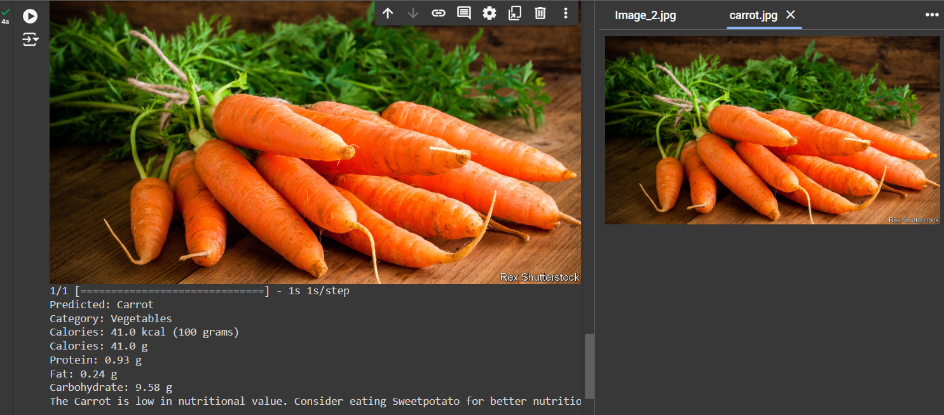
OUTPUTS AND FINAL RESULT

Slide 14
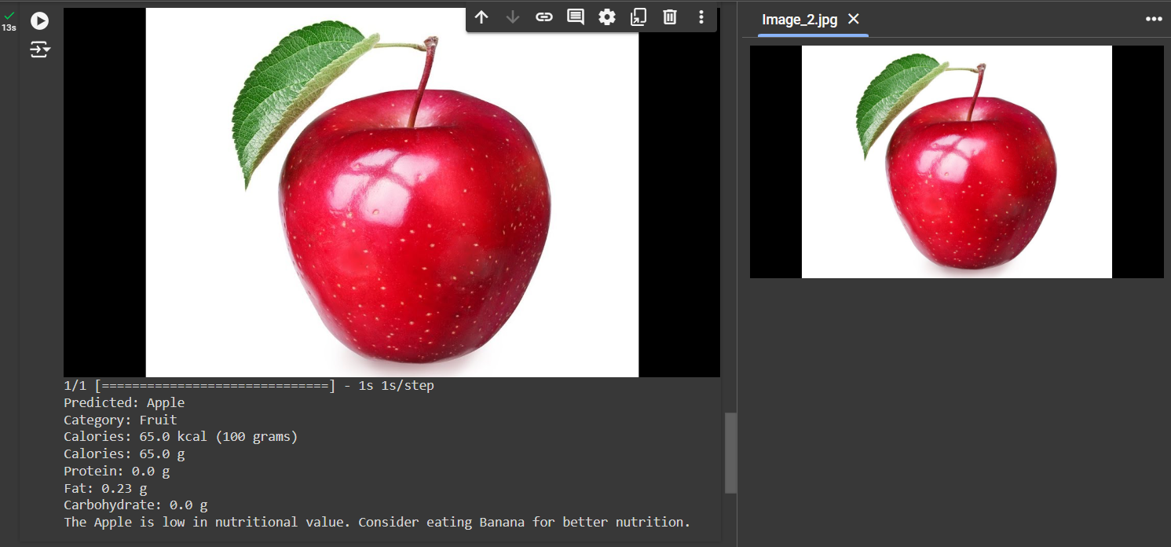
OUTPUTS AND FINAL RESULT

Slide 15
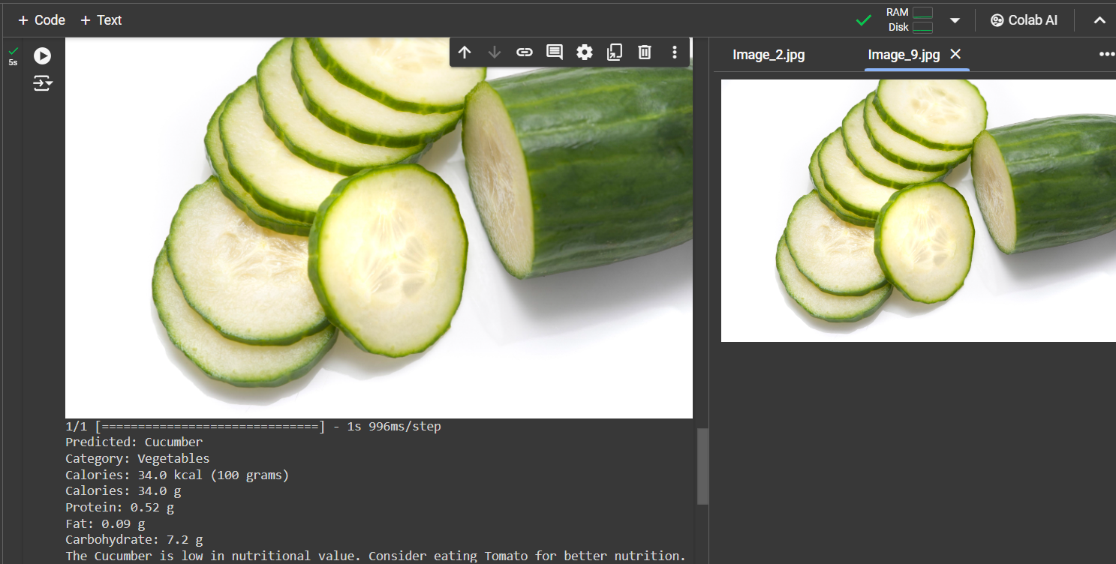
OUTPUTS AND FINAL RESULT

Slide 16
Conclusion and future Enhancement
The proposed system offers a promising solution for automated fruit and vegetable classification and nutritional assessment. Through the integration of deep learning and external nutritional databases, users can make informed dietary decisions with ease. The user-friendly interface facilitates seamless interaction, providing real-time feedback on classification results and nutritional information. By empowering users to make healthier food choices, the system holds significant potential for improving dietary management and promoting healthier lifestyles.
Future Enhancement:
1.Enhanced Accuracy
2.Expanded Food Database
3.Personalization Features
4.Mobile Application Development:

Slide 17
Thank you

